Slide 1



Using Deep Learning to Provide Feedback for Remote Physical Rehabilitation
Remote Rehabilitation: Xian Gao(CS), Molly Meadows(CS), Noah Rieth(CS)
Instructor: Bruce Bolden
Clients: Dr. Alexander Vakanski, Dr. Min Xian

Slide 2
Contents
Objective
Value Proposition
Product Requirements
System Design
Project Management
Risk Management

Slide 3
Objective
Train a neural network model to provide accuracy ratings using videos of physical therapy exercises taken on a smart phone as input.

Slide 4
Value Proposition
Rehabilitation after injury prolonged:
No feedback on their exercises
Practicing exercises incorrectly
No progress on recovery
Can be expensive
Create a way to provide feedback given a video from user of them completing an exercise

Slide 5
Background
A-Deep-Learning-Framework-for-Assessing-Physical-Rehabilitation-Exercises
Deep Learning
OpenPose (Body_25 Model)
Software Used:
Python
Matlab
Jupyter Notebook

Slide 6
Product Requirements
At least one exercise
Numerical accuracy rating
Must be able to analyze a video taken from a smart phone
Must be able to provide feedback in a reasonable amount of time
Project should analyze at least 100 human skeletal movements

Slide 7
MotionGPT
Original plan discussed in Concept Design Review
Could not insert 2D positional data into tokenizer
Not documented well
Not precise

Slide 8
Alternative Plan
Apply the existing models for rehabilitation evaluation to predict quality scores for the Deep Squat exercise
Use OpenPose
Compare and analyze the quality scores obtained by OpenPose, Kinect, and Vicon systems
Record several videos for exercises with a cell phone for testing

Slide 9




Product Design
%
Record Video
Extract Joints
Preprocess Data
Submit to Model
Produce Accuracy

Slide 10
Development Plan
Extract Skeletal Information from an .avi video using OpenPose
Data Preprocessing (missing joints, centering data, label generation)
Train and test the neural network using raw data and labels
Collect videos for different exercises (Incorrect and Correct)

Slide 11
Extracting Data
OpenPose Body_25 Model
Removed the background point
Python
Opencv-python and csv libraries
Smoothing data
Stores joint information in format: (frames, features)

Slide 12
Data Preprocessing
Add z point (set to zero) for each joint extracted for each frame
Episode split
Center data
Numpy
Remove bad episodes that would hinder training
Prepare labels for training

Slide 13
Neural Network
Joint data for incorrect and correct movements and their labels as input
Split training and validation datasets (70% and 30%)
Match 5 main body joints to Vicon joints (trunk, left arm, right arm, left leg, right leg)
Build a temporal pyramid network to train data

Slide 14
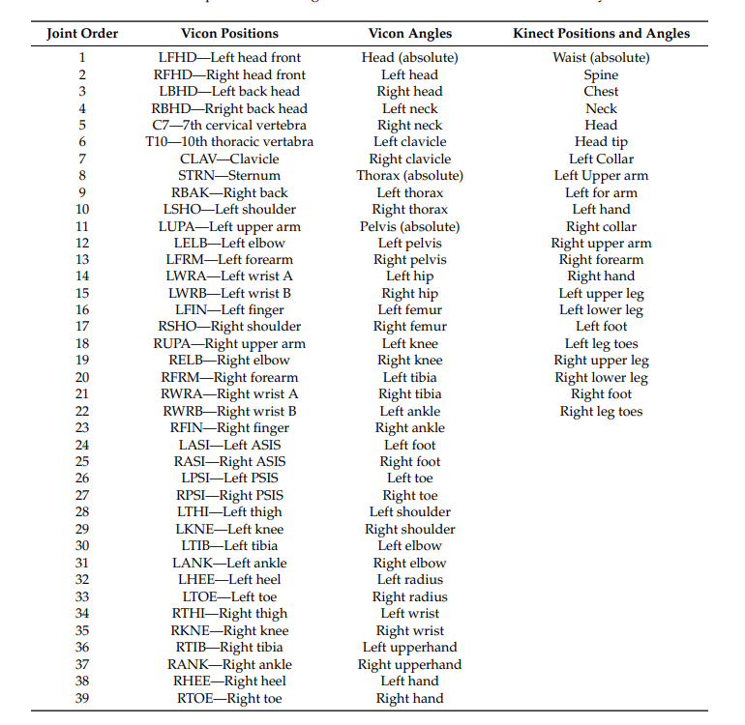
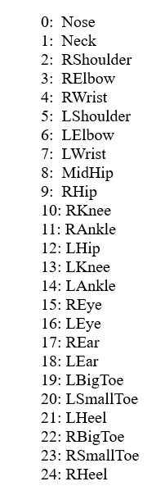

Slide 15
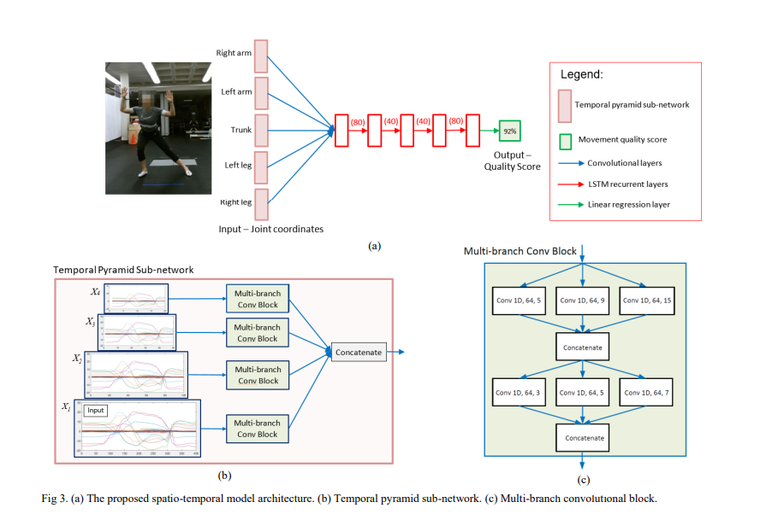
https://arxiv.org/ftp/arxiv/papers/1901/1901.10435.pdf

Slide 16
Task 1 Overview
Deep Squat
Preprocess given videos
Build and train model based on the given SpatioTemporalNN (neural network) using OpenPose data
Modify the existing temporal to better suit the OpenPose data

Slide 17
Task 1
Select 417 frames from each video, evenly distributed
Analyze each frame with OpenPose and save the joint positions (z set to 0)
Split into episodes and reshape data to this structure:
(subjects * episodes * features, frames // episodes)
Center and scale the data from –1 to 1
Remove bad episodes
Train the temporal pyramid neural network

Slide 18
Results (Input)
Reduce from 41 frames per repetition to 40
Half scale sequences for the pyramid model
180 repetitions total (correct and incorrect)
(subjects * episodes * features, frames // episodes) X2
(6750, 40) data points, one for correct , one for incorrect
No smoothing

Slide 19
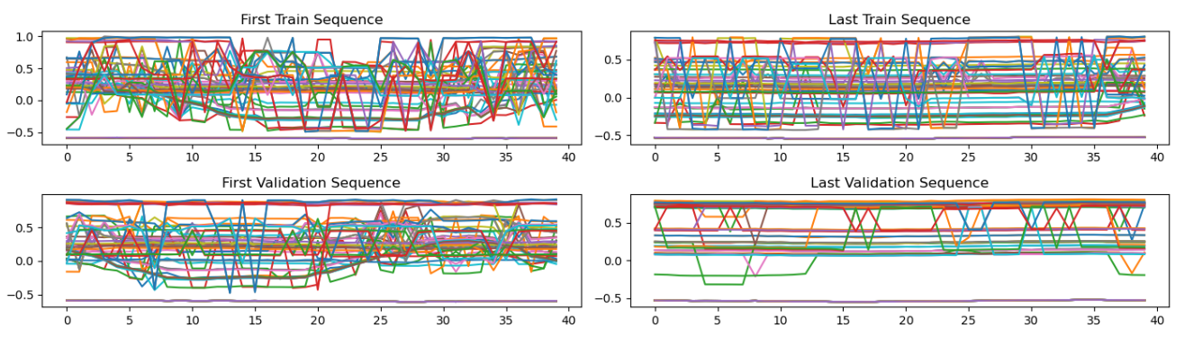
Joint Positions vs Frame Count for Random Episodes

Slide 20
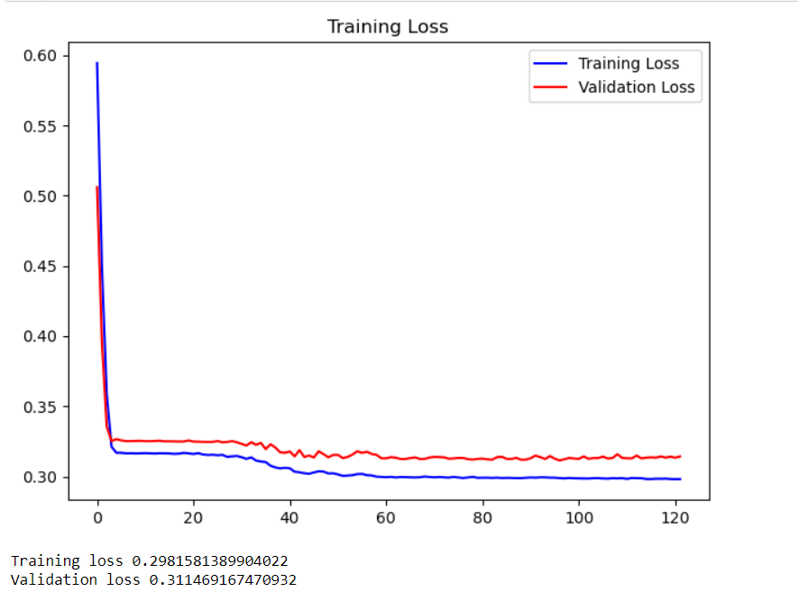

Slide 21
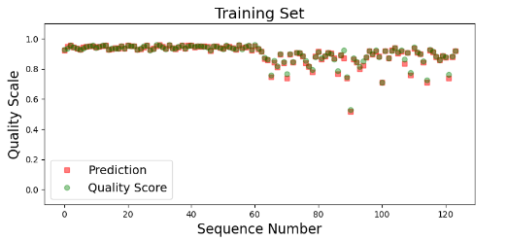
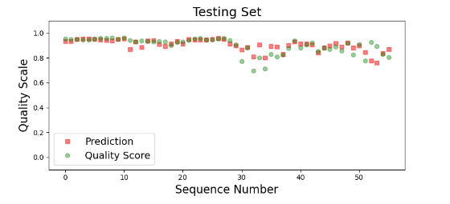

Comparison between Predicted Quality and Label

Slide 22
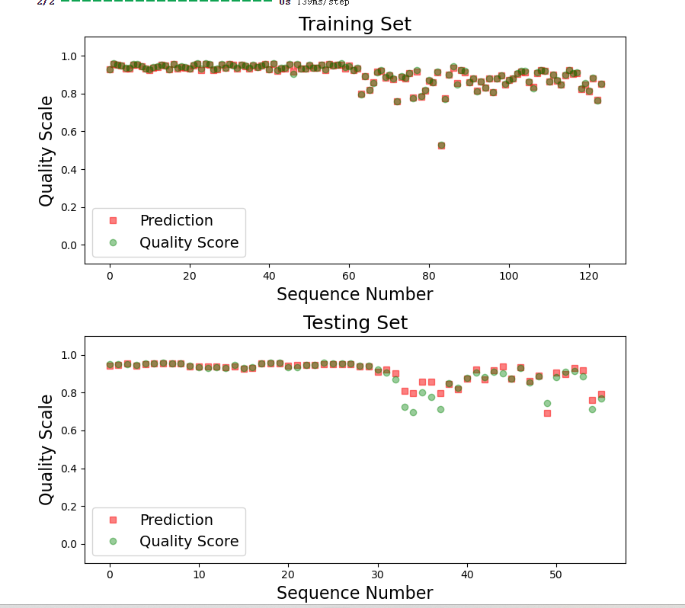
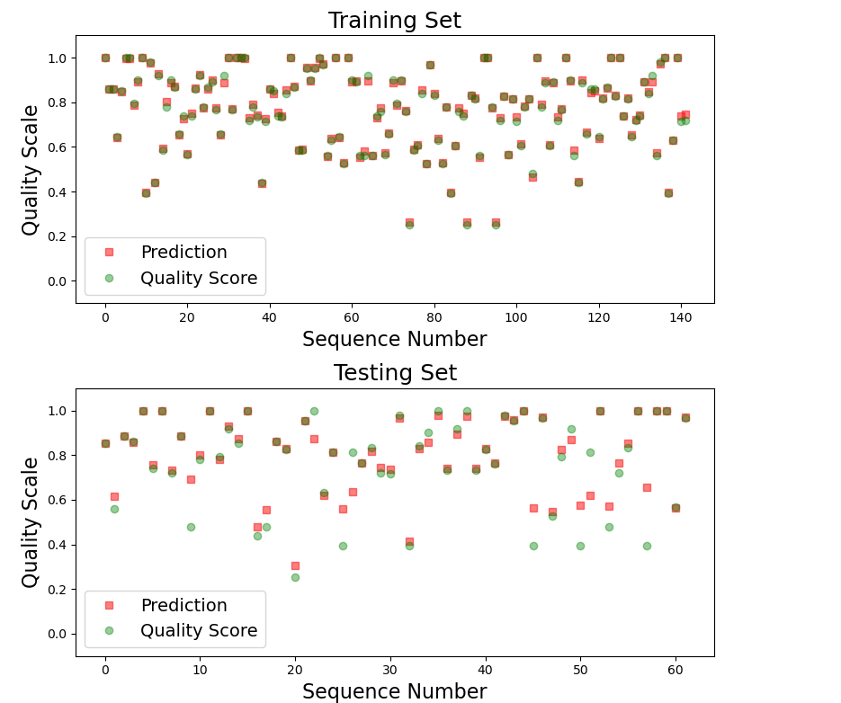
Task 2
Quality score of exercise 1 from Vicon system
Quality score of exercise 1 from Kinect system

Slide 23
Task 2
Import the correct data, incorrect data , correct score and incorrect score of squat exercise from GitHub repo which Dr. Vakanski provided with us.
Modify the timestep, number of repetitions, and dimension of the data sequences to suit our requirements.
It's obvious to compare the quality scores graph for squat exercise from NN model based on the systems.

Slide 24
Next Steps (Task 3)
Test model with collected videos of correct and incorrect videos of the Deep Squat exercise
Collect videos of another exercise (10 repetitions)
Incorrect and Correct versions
Prepare labels for training other exercises

Slide 25
Schedule
Snapshot #3: 3/26
Better Data Preprocessing
Use better episode split in training model
Produce score for one video input
Engineering Expo: 4/25 - 26
Model able to train on multiple exercises
Basic user interface to show off at expo
Audience member submit video for analysis

Slide 26
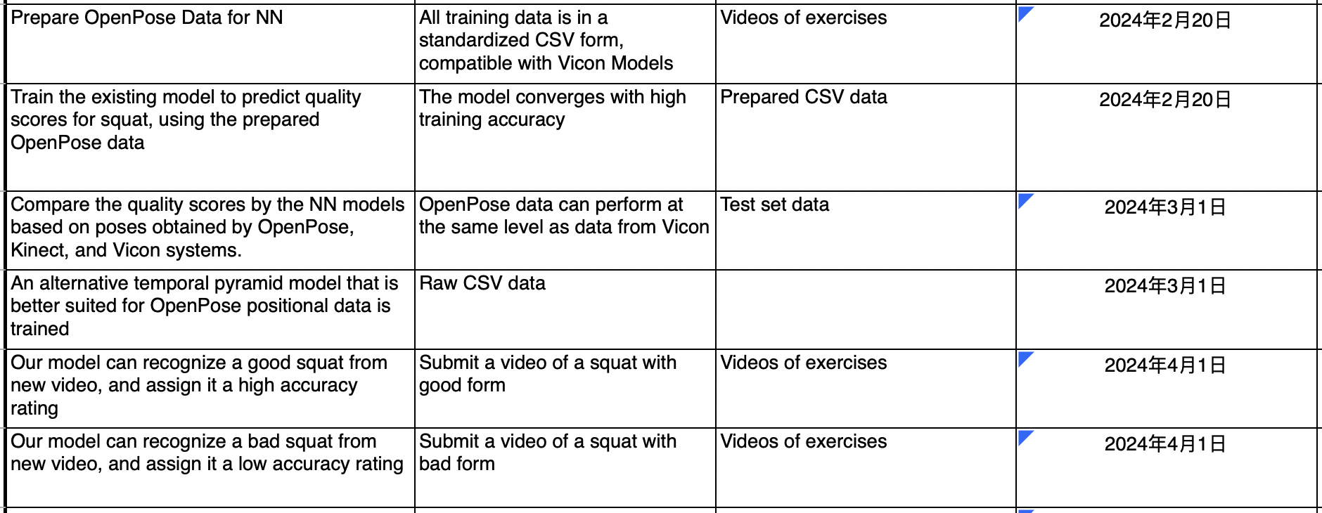
Validation

Slide 27
Improvements if time
No longer using an LLM
We can still output a list of common mistakes made when doing that exercise
Changing part of the label process for incorrect movements so that bad movements are scored lower

Slide 28
Risks
We have currently only undertaken work related to squat recognition and scoring, and recognition and scoring for other movements have not been completed
OpenPose joint estimation and associated logic is not mature enough for a model to converge, especially for other exercises

Slide 29
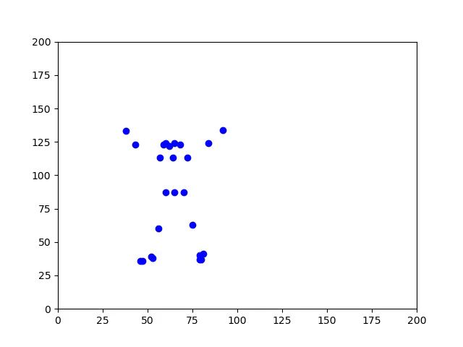
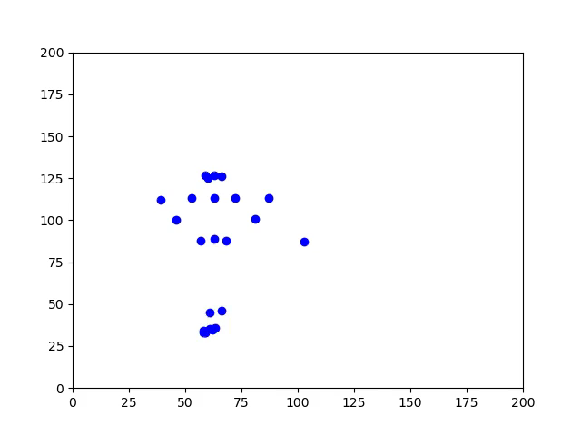
Data Demonstration

Slide 30
SLIDES TO USE FOR SNAPSHOT

Slide 31
Using Deep Learning to Provide Feedback for Remote Physical Rehabilitation
Remote Rehabilitation: Xian Gao(CS), Molly Meadows(CS), Noah Rieth(CS) ​
Instructor: Bruce Bolden​
Clients: Dr. Alexander Vakanski, Dr. Min Xian

Slide 32
Objective
Train a neural network model to provide accuracy ratings using videos of physical therapy exercises taken on a smart phone as input.

Slide 33
Value Proposition
Rehabilitation after injury prolonged:
No feedback on their exercises
Practicing exercises incorrectly
No progress on recovery
Can be expensive!
Create a way to provide feedback given a video from user of them completing an exercise

Slide 34
Product Requirements
At least one exercise
Numerical accuracy rating
Must be able to analyze a video taken from a smart phone
Must be able to provide feedback in a reasonable amount of time
Project should analyze at least 100 human skeletal movements

Slide 35
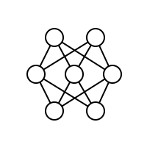

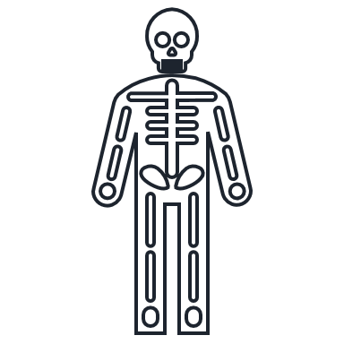

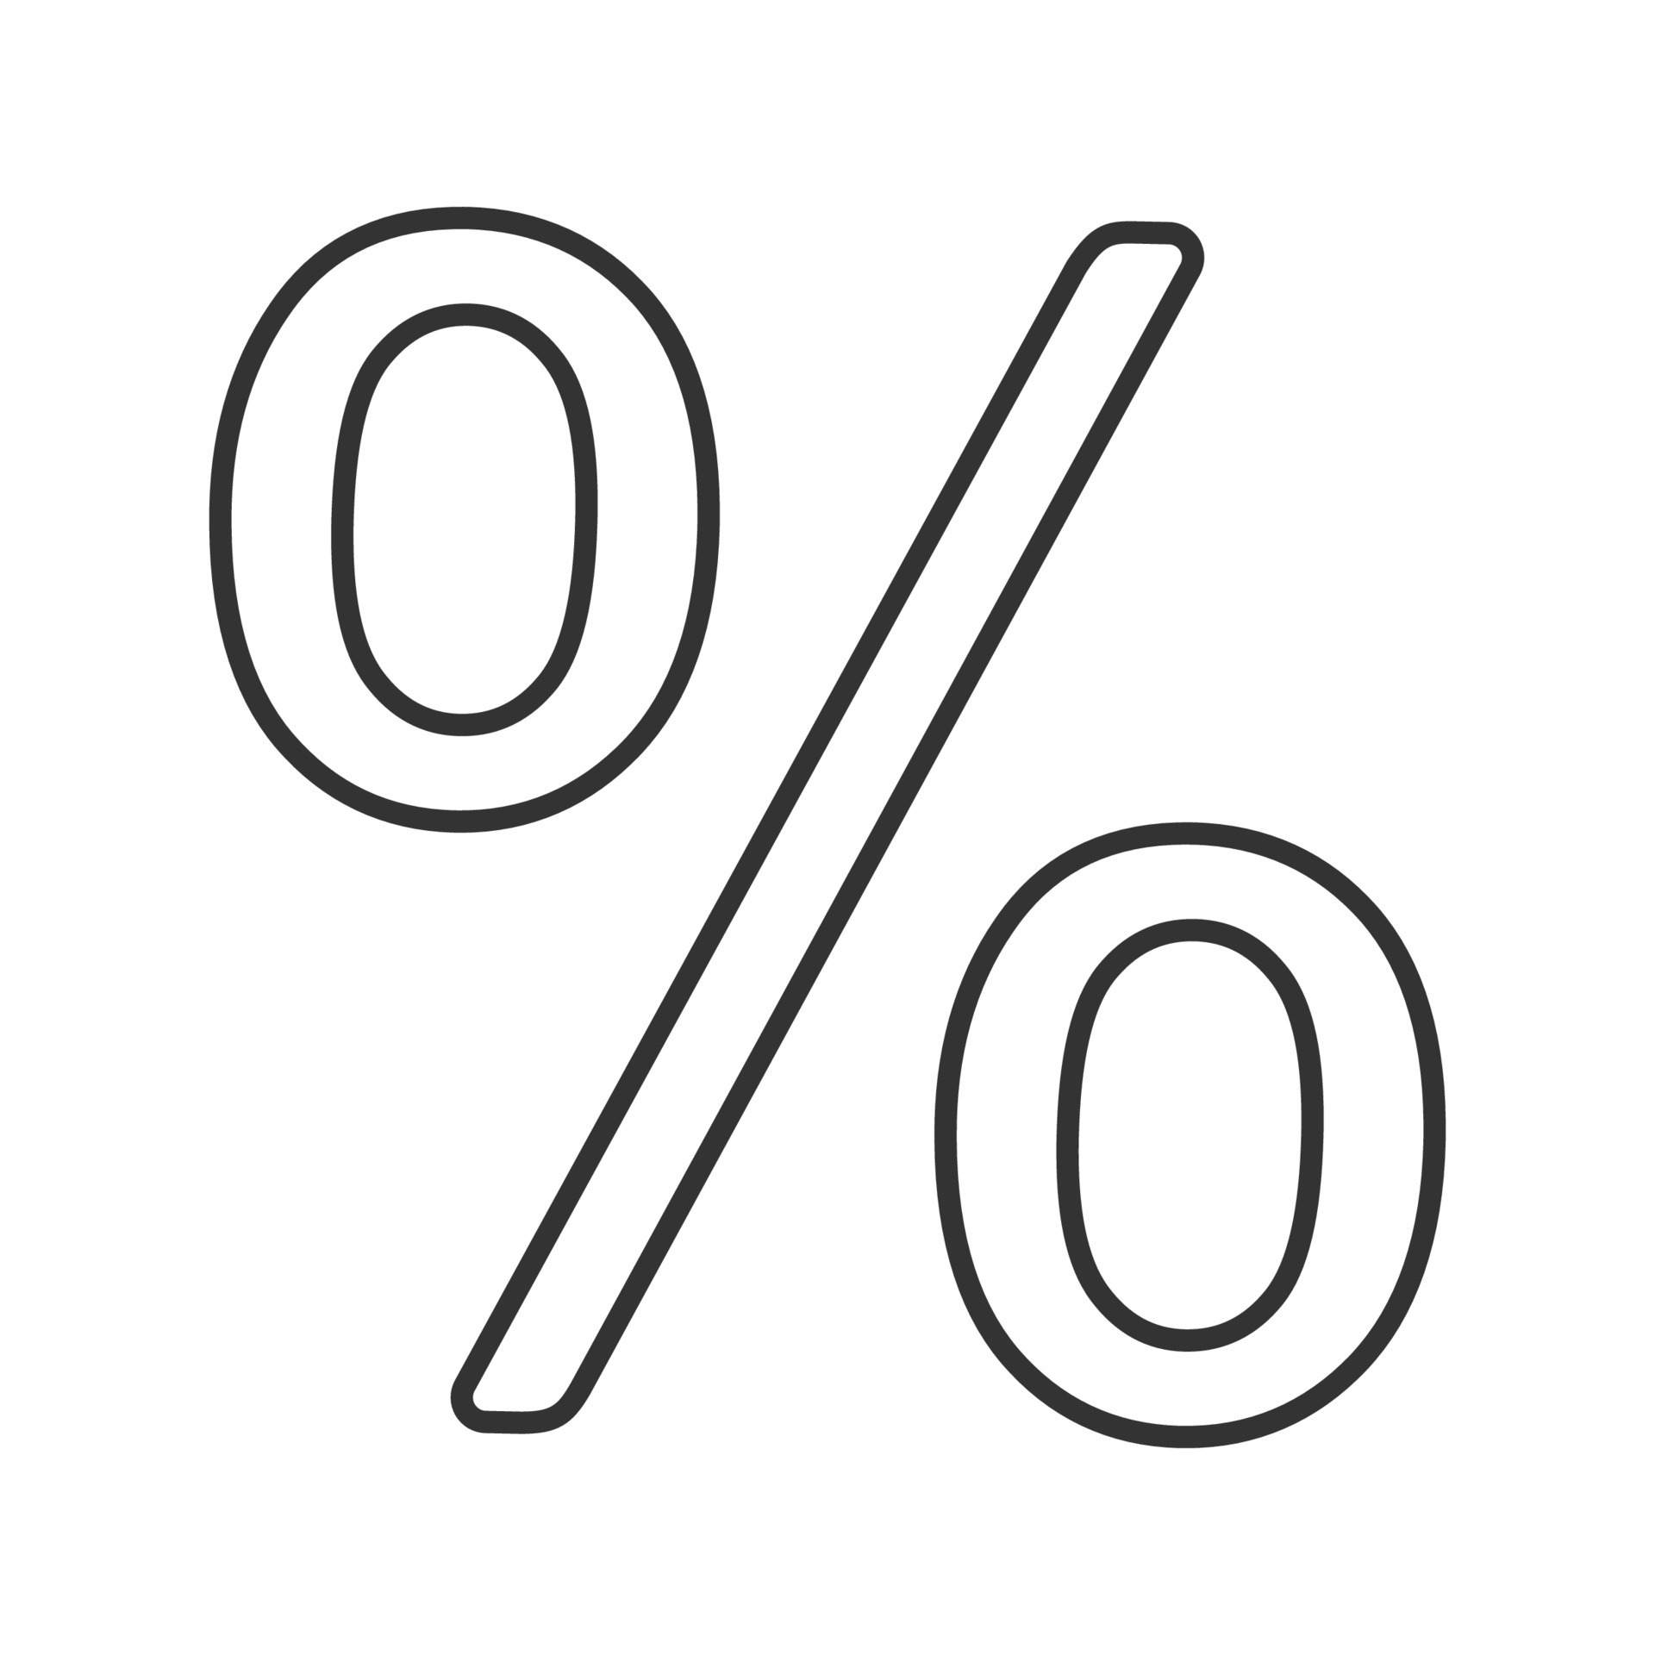
Product Design
Record Video
Extract Joints
Preprocess Data
Submit To Model
Produce Accuracy

Slide 36
Development Plan
Extract Skeletal Information from an .avi video using OpenPose
Data Preprocessing
(missing joints,
centering data,
label generation)
Train and test the neural network using raw data and labels
Collect videos for different exercises (Incorrect and Correct)

Slide 37
Neural Network
Joint data for incorrect and correct movements and their labels as input
Split training and validation datasets (70% and 30%)
Match 5 main body joints to Vicon joints (trunk, left arm, right arm, left leg, right leg)
Build a temporal pyramid network to train data

Slide 38
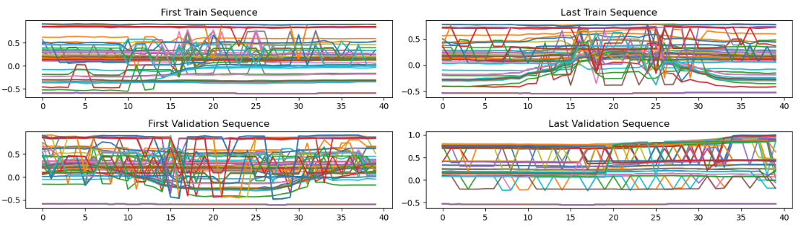
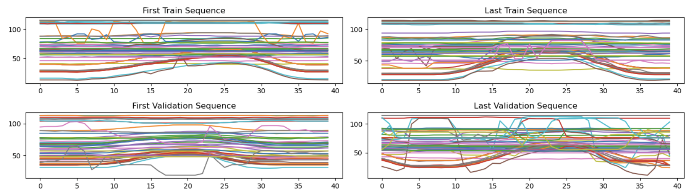
Results from OpenPose System
Raw Data
Preprocessed Data

Slide 39
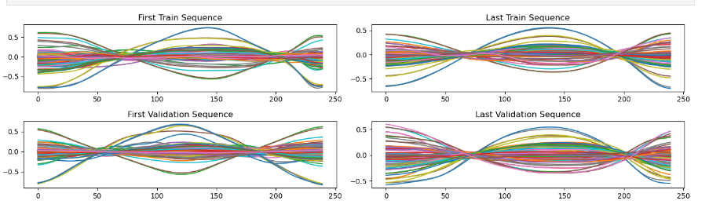
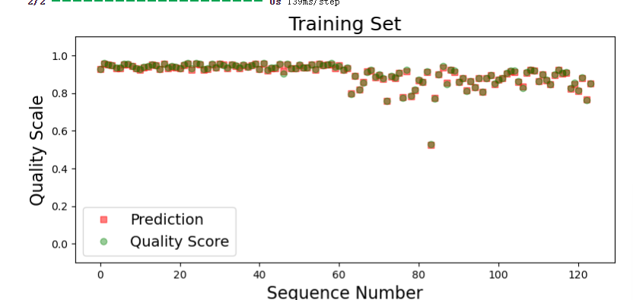
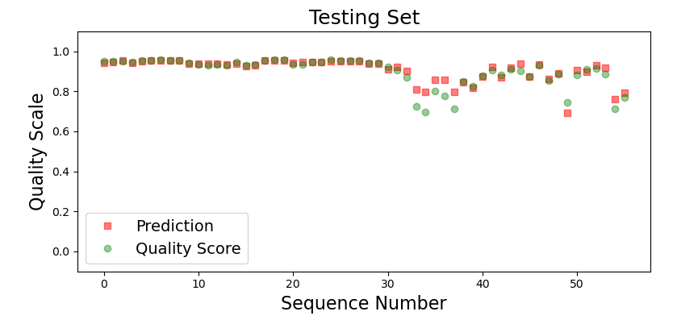
Results from Vicon System

Slide 40
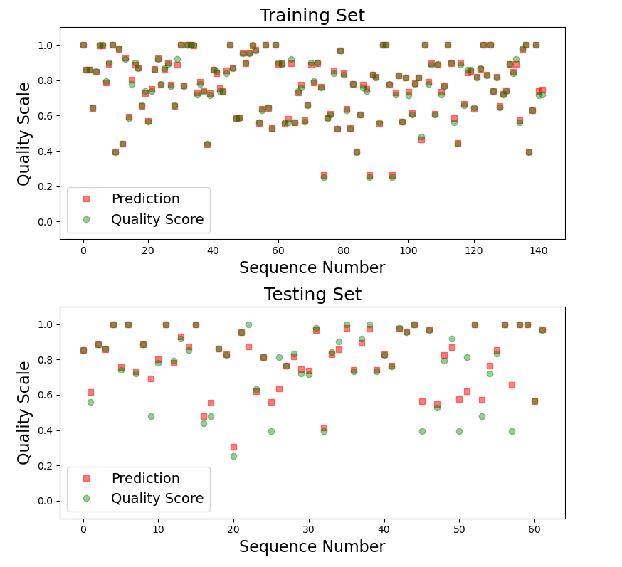
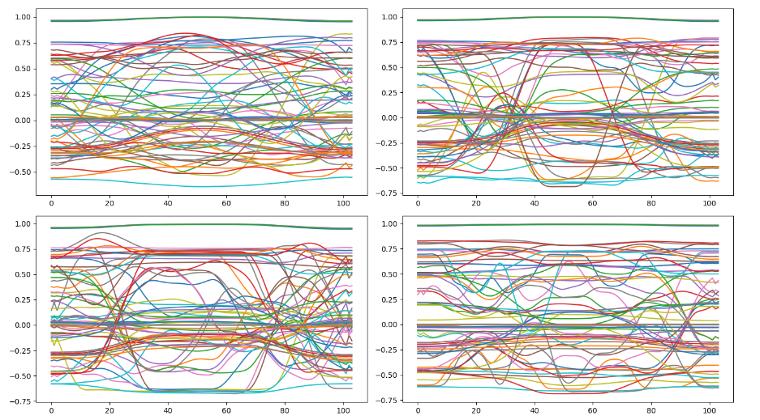
Results from Kinect System

